Slide 1


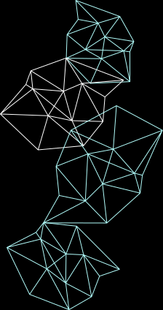
James Liounis
Kimberly Llajaruna Peralta
Hope Neveux
Michael Sam
1
2
3
4
Overview
Primary Arcitecture
Demo
In Development

Slide 2

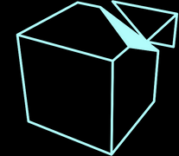


Automatic Test Generation For You, By You
Overview
Step 1
Active-Recall ranks as one of the most maximal learning strategies for retention and application
By uploading handouts or technical figures, you can get custom question banks with reliable answers and feedback instantly
Upload a document or image to our website
Step 2
Choose your test type:
Multiple Choice Questions
Short Answer
MCQ + Short Answer
Custom Test Prompt

Slide 3


Dynamic Quantization
Finetune with COCO
Open LLaMA 7B
ViLT-32b-finetuned-vqa
Pruning
Multiple Choice Questions
Visual Question Answering
Weights & Biases
Custom Containers
Serverless Training
Vertex AI
Vertex AI
Time Efficient
Task Specific
Flexible
No more aurdiously creating flashcards or lesson plans by hand.
By uploading your readings or class notes, you can interact with the material and be test-ready faster.
Rather than ask ChatGPT about concepts in your materials, you directly upload the information for our LLM to extract information from.
Learn at the pace that works for you.
You can customize the kind of test you get, how many questions you want, if you want repeats, and the difficulty of your test.

Slide 4
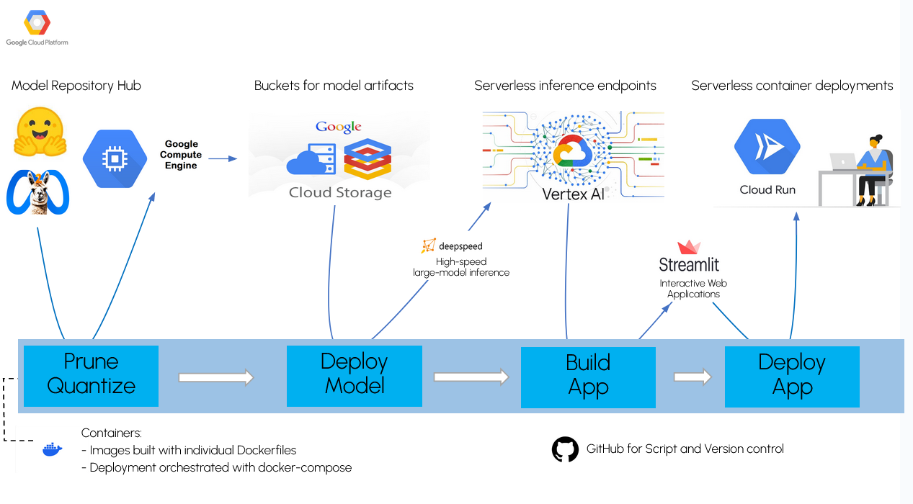

Slide 5
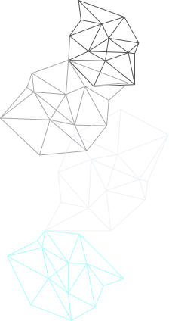
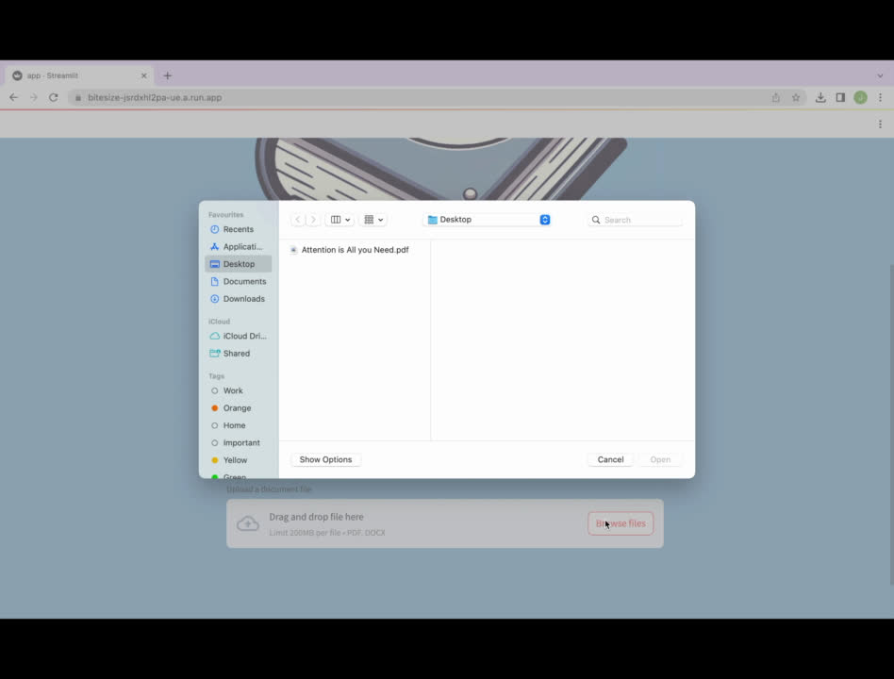

Slide 6
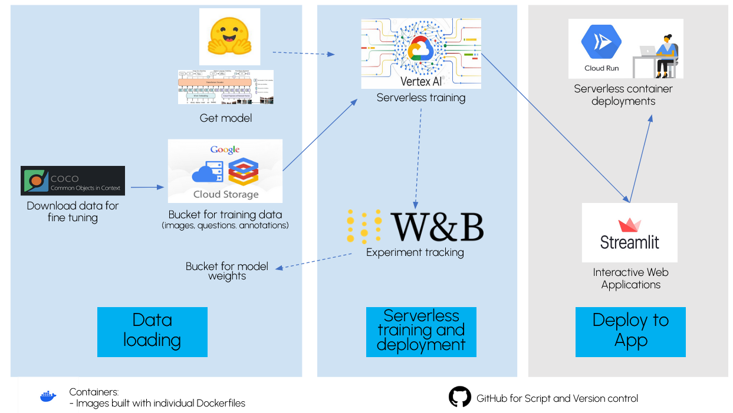

Slide 7
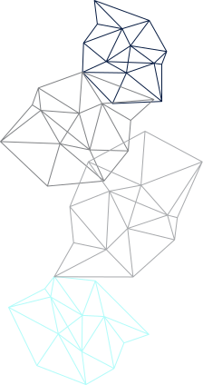
VQA Deployment
Our VQA model critically supports learning. While fine-tuned, it is not yet publically accessible.
APIs & Frontend Integration
Integrate Text-Model and VQA to the frontend for a seemless user experience
Next Steps
Scaling & Automated Deployment
Continue to refine our Kubernetes-based scaling solution, integrating VQA. We will also be looking into automating our deployment with Ansible.

Slide 8
Questions
Team Name
BiteSize
Team Members
James Liounis
Kimberly Llajaruna Perlta
Hope Neveux
Michael Sam

